Slide 1
Data Analytics Guideline
28th Meeting
of the INTOSAI Working Group on IT Audit
(Nadi, Fiji) 2 - 3 April 2019
Notes:
© Copyright PresentationGo.com – The free PowerPoint library

Slide 2
Agenda
Project Overview
Milestone List
Guideline Contents

Slide 3
Project Overview
Name of Project : Data Analytics (Area: IT Audit Techniques)
Leader : SAI Indonesia
Member SAIs are: Bangladesh, Brazil, Ecuador, Georgia, India, Iran, Iraq, Japan, Malaysia, Pakistan, South Africa, and USA
Time Frame: 2016 - 2019

Slide 4
Milestone List
PID approved
(November 2016)
Project Plan approved
(Q1, 2017)
Final Draft completed
(Q1, 2019)
Request for Inputs and QA Process
(Q2 - Q3, 2019)
Data Analytics Guideline completed
(Q4, 2019)

Slide 5
Guideline Contents
Introduction
Initial Stage of Data Analytics Process
Data Readiness
Analytics Creation
Business Intelligence
Analytics Deployment
Data Analytics in Audit
Data Analytics Project Management
Notes:
© Copyright PresentationGo.com – The free PowerPoint library

Slide 6
1. Introduction
Purpose
Provides the concept of data analytics and generic processes of implemention
Data Analytics
Data Analytics is regarded as a computation process of Data Analysis. The computation process involves several phases such as collecting data, cleansing data, analyzing data, and deploying data.

Slide 7
2. Initial Stage of Data Analytics Process
Identifying The Target
Defining the target needs sharp questions that are relevant, specific, and unambiguous.
Identifying The Data Source
The output of this task is the list of data that are available and required for the analysis.
How much or How many; Which Category; Which Group; Is this weird; Which option should be taken?
A typical document of this task is the data dictionary.

Slide 8
3. Data Readiness
Data Source Identification
Data Acquisition
Data Cleansing
Data Management

Slide 9
Data Source Identification
Data Source
Internal:
- Data generated through Audit Process
- Audit Entity Profile
- Any other audit-related data available in Data Center.
External:
- Audit Entity’s Data which includes financial and non-financial data
- Other data available in public domain.

Slide 10
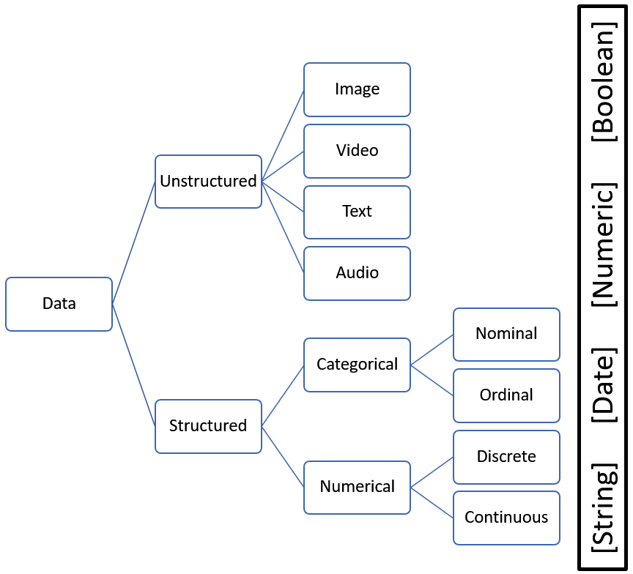
Data Acquisition (1)
Type of Data

Slide 11
Data Acquisition (2)
Access Method
Read-only access to the database
A high degree of freedom of selecting the data and arranging the data to fit the need
Requires an extensive knowledge on creating query and the data structure itself
Backup-Restore mechanism
A kind of cloning auditee’s database
Auditors conduct data analytics in an isolated database
Delivering the requested data through LAN-WAN or VPN
A limited interaction with auditee’s database management system
Auditee put the file needed by auditors on the location in which auditor has right to access the file through organization network using Wi-Fi or Cable
Auditors should have the same database management system

Slide 12
Data Acquisition (3)
Data Extraction
The data are stored in several locations such as from a database management system, a website, and a file
In order to avoid the risk of altering the original source

Slide 13
Data Cleansing
Incorrect Data
Has been incorrectly added to the database
Affects the Validity, Accuracy, and Consistency, thus, lowering the quality of the data
Corrupt Data
Caused by system either during transmission or during extraction
Missing Data
Affects the Validity, Accuracy, Completeness, Consistency, and Uniformity
Does not exist in the dataset
Affects the Validity, Accuracy, Completeness, Consistency, and Uniformity

Slide 14
Data Management
Auditors should take time to manually look through the data for the last time before running the analytic algorithm
Auditors should make sure that they work with auditable data. Typical techniques to make sure the data are ready for further analysis:
Control Total
Checking the columns for skewness
Checking the columns that are susceptible to corruption

Slide 15
4. Analytics Creation
Model Creation
Model Training
Model Evaluation

Slide 16
Model Creation
Descriptive Analytics
Descriptive Analytics is the process of Data Analytics that creates an overview of the data
Diagnostic Analytics
Diagnostic Analytics enable auditors to find out the degree of integration among information and identify the reason of why something happened
The benefit of Diagnostic Analytics are: Identification of Outlier, Information Discovery, Uncovering the Causal Relationship
Predictive Analytics
Predictive Analytics is the process of Data Analytics that creates the estimation of about the likelihood of an upcoming output or outcome
Summarizing, Cross Tabulation, and Grouping are the common technique to conduct Descriptive Analytics.
Five issues should be taken into account are: A target, Indicators, Sufficiency of historical data, Proper Algorithm, Accuracy

Slide 17
Model Training
Model Training is the process that involves several processes such as
Splitting the data into two part, i.e., for training and for testing,
Selecting algorithm, and
Tuning the statistical feature

Slide 18
Model Evaluation
Confusion Matrix
Confusion Matrix is a table for explaining the accuracy of a classification model on a set of test data for which the true values are known
Receiver Operating Characteristic (ROC)
Receiver Operating Characteristic (ROC) is a graph that represents the performance of a classification model at all classification thresholds
Area Under the Curve (AUC)
Area Under the ROC Curve (AUC) has been proposed as the alternative metric as a complimentary of ROC Curve. Many existing learning algorithms have been modified in order to seek the classifier with maximum AUC
This table shows a level of accuracy of predicting the values and the actual values

Slide 19
5. Business Intelligence
BI integrates the results of Data Analytics and the power of Data Visualization
Data Visualization
Static Visualization
(tabular or graphical mode)
Dynamic Visualization
(clickable on most area of visualization)
Decision Support
Sunburst Diagram
(visualize hierarchical data, depicted by concentric circles)
Insight
Dendogram
(a tree diagram)
Network Diagram
(visualise complex relationships between a huge number of elements)

Slide 20
6. Analytics Deployment
After analytics appears to be performing satisfactorily, it can be deployed into production for other applications to be consumed (online websites, spreadsheets, dashboards, line-of-business applications, and back-end applications)

Slide 21
7. Data Analytics in Audit (1)
AICPA has defined DA in audit as "the science and art of discovering and analyzing patterns, identifying anomalies, and extracting other useful information in data underlying or related to the subject matter of an audit through analysis, modeling, and visualization for the purpose of planning or performing the audit”
DA can contribute to every phase of the audit
Auditor should consider DA that meet with the audit objective

Slide 22
7. Data Analytics in Audit (2)
DAs might be viewed as an evolutionary form of CAATS that have, for example, enabled the auditor to make more effective use of data visualization techniques and help achieve a broader range of audit objectives
In using DA, auditor must pay attention to the relevance and reliability of the data
When DA involve 100 percent of items in sizeable populations, the auditor may initially identify a large number of items requiring some form of auditor consideration to ensure that risk is sufficiently low
Auditor requires to document the identifying characteristics of the specific items or matter tested

Slide 23
8. Data Analytics Project Management
initiating
planning
Executing
Closing
Monitoring & Controlling
Defined audit objectives, Identified audit approach, Identified audit tests, Can DA be used?, reosurces of audit team, availability of data
Clearly define requirements of analytics, Identify data sources, Create time estimates (budget), Prioritize analytics
Retrieve data, Validate data, Code analytic routines, Confirm results, Re-­code as necessary
Monitor completed objectives, Monitor time budget, Were additional areas to examine identified?, Does it make sense to continue?
Have we met the defined objectives?, Were additional areas to exam identified?, What are our lessons learned?, How did the analytic effort enhance the audit?

Slide 24
Any Inputs Would Be Appreciated and Thank You

